Slide 1
5.3 Dynamic View(1)
Communication Diagram: registerNode
1.2: registerNode(NodeId, ServerInfo, Serial)
:NodeManager
:Discover
1.5: onRegisterEvent
(Result, ThingList)
1.6: onRegisterEvent
(Result, ThingList)
1.1: registerNode(NodeId, ServerInfo, Serial)
1.4: resultRegistered
(Result, ThingList)
1.3: registerNode(NodeId, ServerInfo, Serial)
:UI Controller
:SA-Node(Arduino)
3: updateRegister
(Result)
1: registerNode(NodeId, Serial)
Sa-Node verify for security whether serial input from user is the same with SA-Node’s.
2: [Result=Autorized]
storeThings(ThingList)
:UI View
:DB
: Note
: Object
: Link
: Asynchronous
: Synchronous or Call
: Reply
registerNode(Serial)
Serial is input by User. User can recognize it from SA node’s physically label.

Slide 2
5.3 Dynamic View(2)
Communication Diagram: Control actuator
1.2: ActionControl(nodeid
,thingid,type,value)
:NodeManager
:Link
Rule Manager
Check rule sets and decide denial of control
[Result=Success]
1.1a : ActionControl(nodeid,thingid,type,value)
1.3: ActionControl(nodeid
,thingid,type,value)
:RuleManager
[Result=Deny]
1.1b: Result of denial
1.1: controlThing(nodeid,thingid
,type,value)
:SA-Node(Arduino)
:UI Controller
Sa-Node
control actuator
[Result=Deny]
1.1b.1: Result of denial
1: controlThing(nodeid,thingid
,type,value)
controlThing(selection,value)
: Note
: Object
: Link
: Asynchronous
: Synchronous or Call
: Reply
:UI View

Slide 3
5.3 Dynamic View(3)
Communication Diagram: Monitor sensers/actuators
1.1: UpdateThingInfo(nodeid
,thingid,type,value)
:NodeManager
:Link
[Value change]
1.1.1: UpdateThing(NodeId
,ThingId,value)
[Value change]
1.1.1: UpdateThing(NodeId
,ThingId,value)
UpdateThingInfo(NodeId
,ThingId,value)
:RuleManager
:UI Controller
Rule Manager
Check rule sets and decide action-control
1: updatelThing(NodeId
,ThingId, value)
:UI View
: Note
: Object
: Link
: Asynchronous
: Synchronous or Call
: Reply

Slide 4
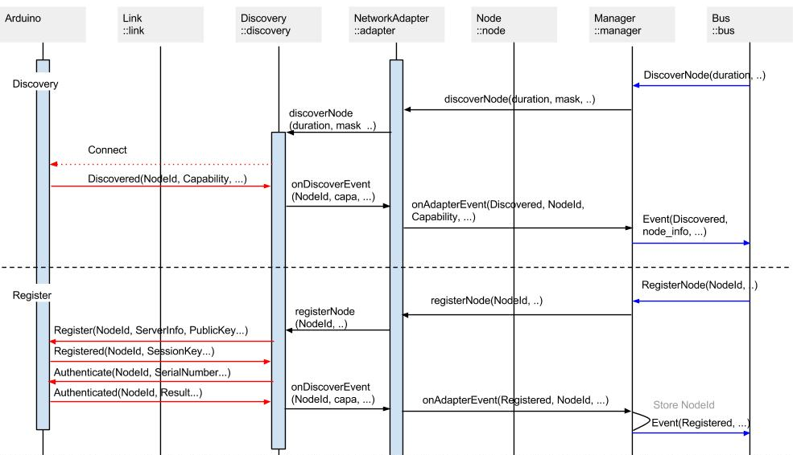
5.3 Dynamic View(4)
Sequence Diagram: discoverNode, registerNode

Slide 5
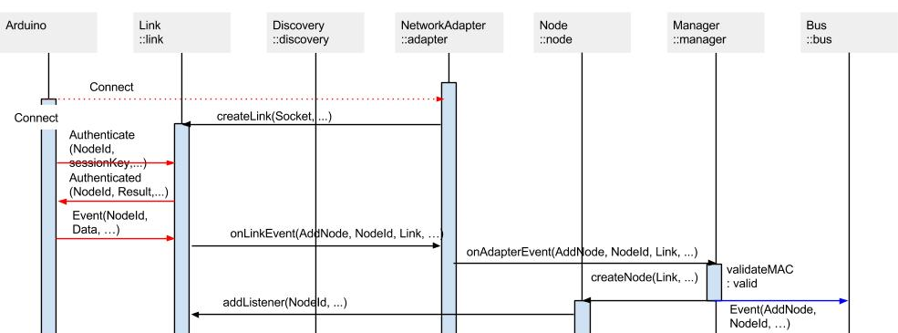
5.3 Dynamic View(5)
Sequence Diagram: Connect

